Slide 1

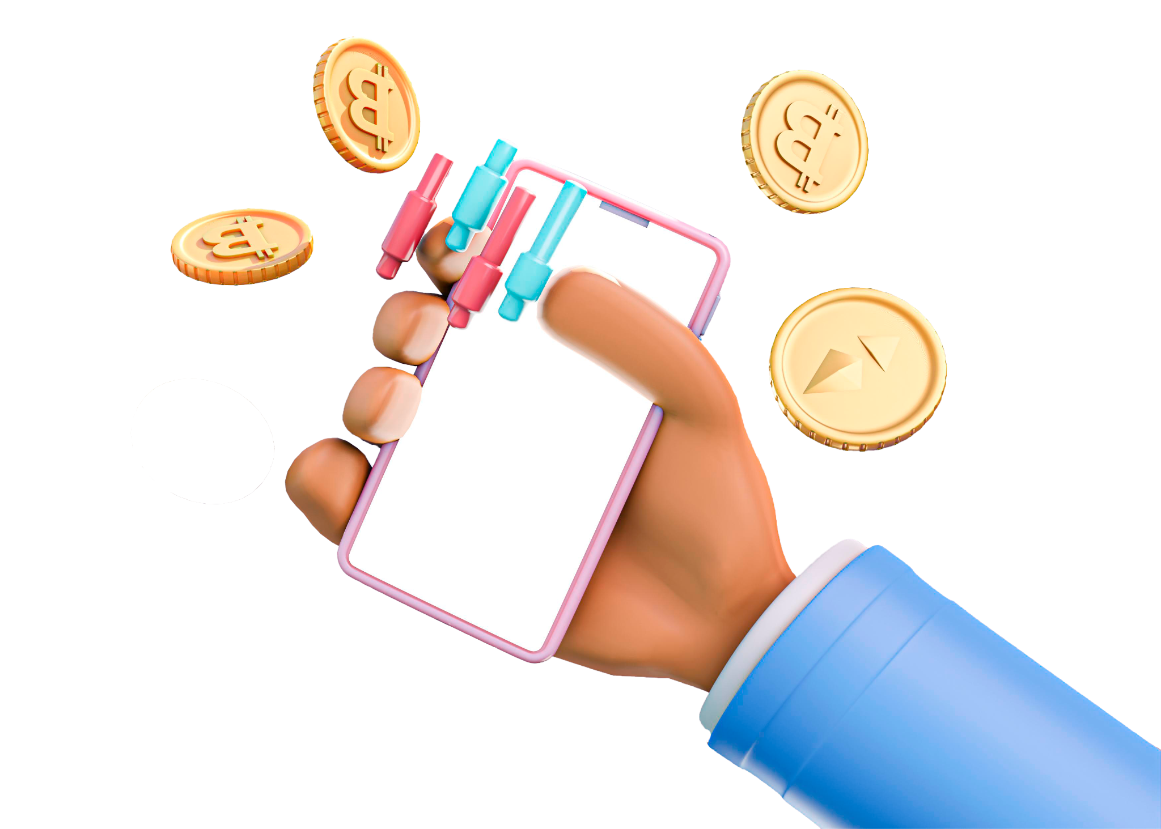
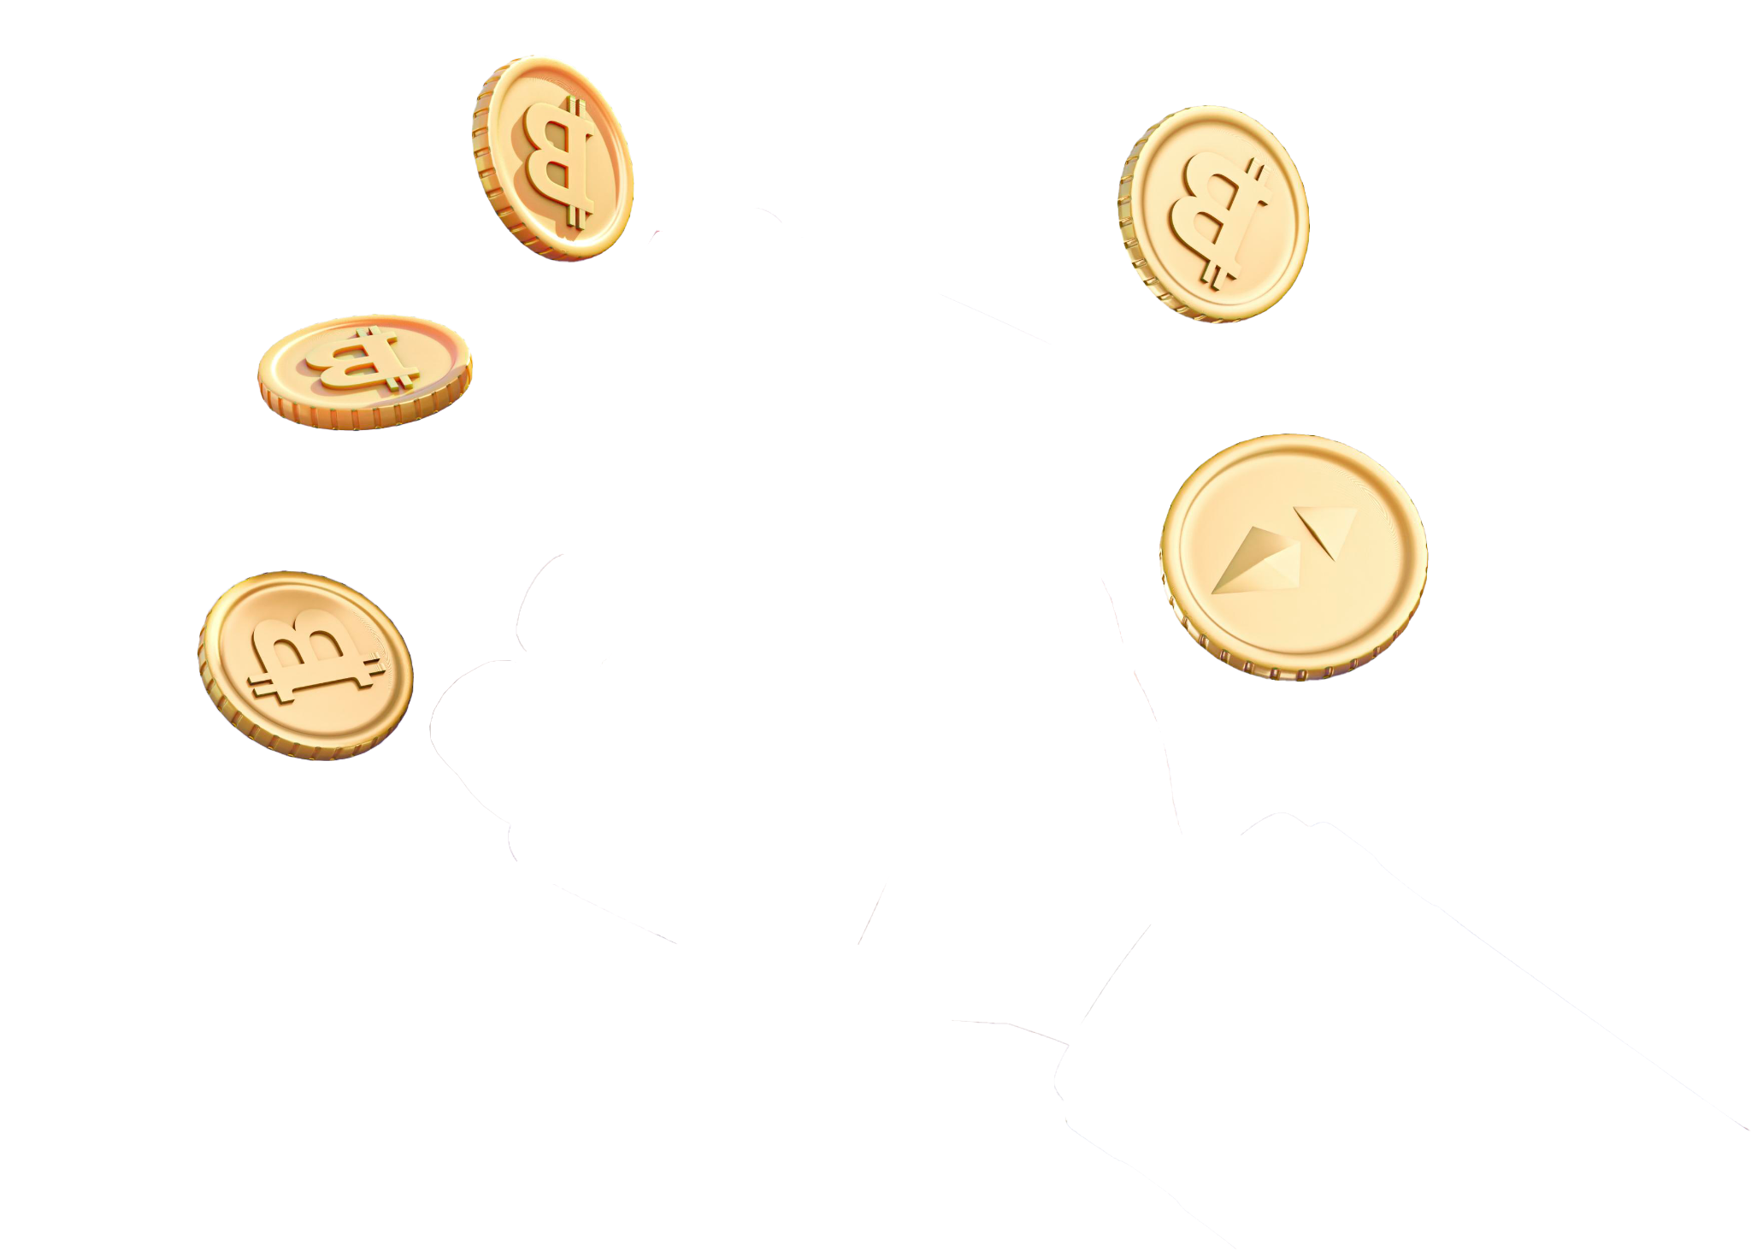
Rexford Goodstein
Steve Teeters

Slide 2
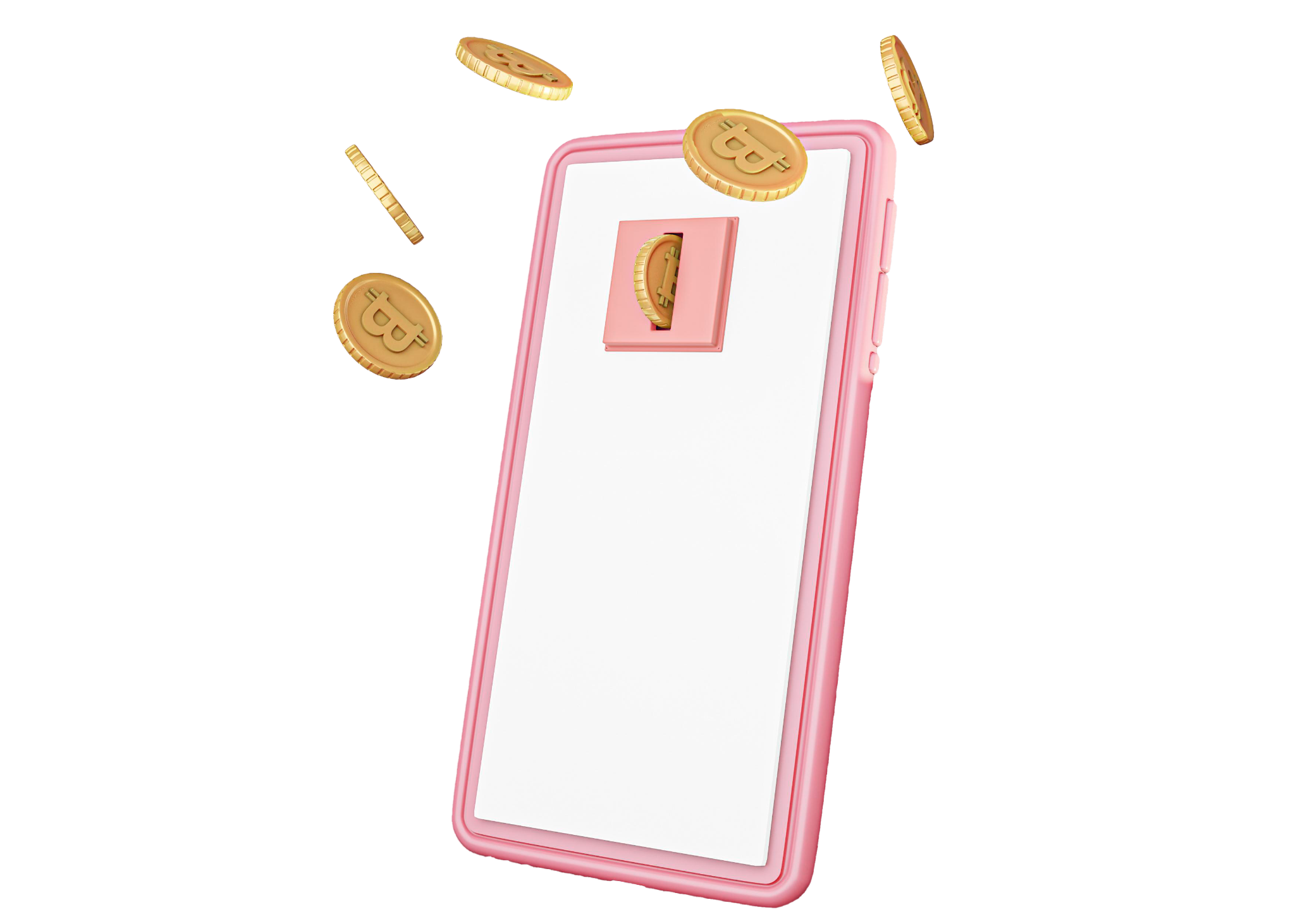
Create a blockchain for the mining and distribution of donations from the donor to the end recipient creating a secure method of moving funds. We will create a main account for the charity to mine tokens that we create that has a value tied to the USD. Donors will purchase Ethereum to then purchase the mined tokens as a donation to the charity. End recipients will be able to use the funds in their own communities to help boost the local economies.
Concept

Slide 3
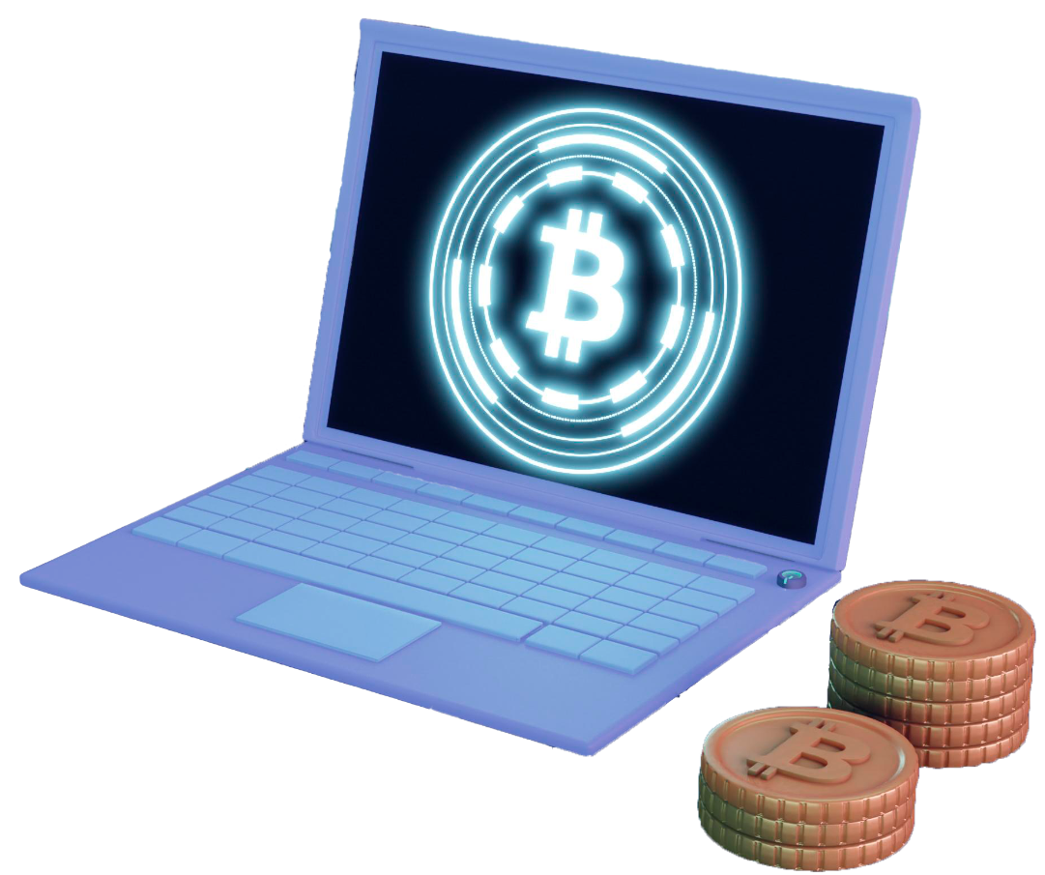
Initial Steps
[x] Step 1: Create wallet for charity which will mine the coins based on the USD and be the main wallet for the project.
[x] Step 2: Create wallets for the In-Country Partners.
[x] Step 3: Main charity wallet will then pass the donated USD based coins that were mined and purchased to the in-country partners’ wallets.
[x] Step 4: Create wallets for the individuals who will be receiving the final donation to be able to accept and use the coins.
[x] Step 5: Create wallets for the vendors to receive coins from individuals and turn back into the charity.

Slide 4
Access Control of Functions
Donor_Role •Acquired from donating Ethereum. This makes a 1:1 exchange of Wei to token. •The tokens are minted when the exchange takes place
Minter_Role •The contract owner can mint coins as a way to boost the program to initial donors as an incentive
Your logo

Slide 5
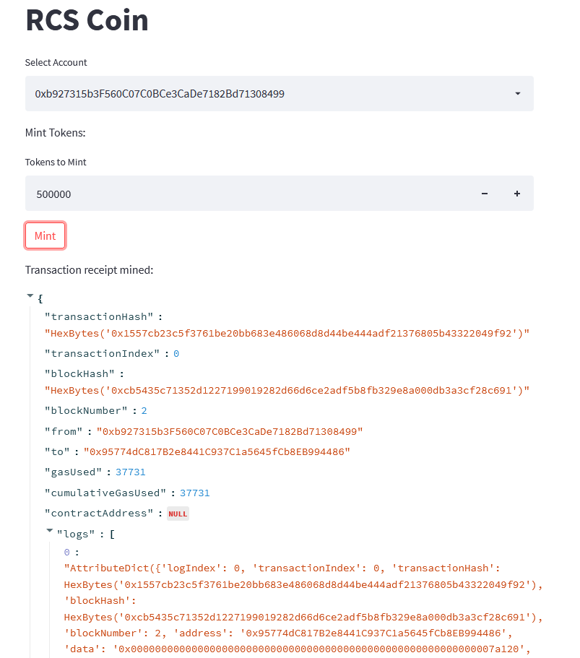
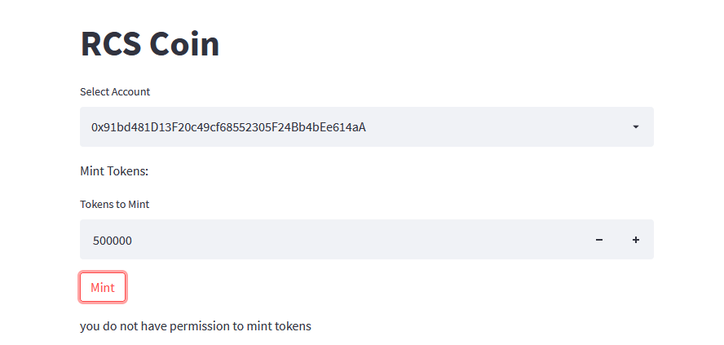
Successful Minting
Unsuccessful Minting

Slide 6
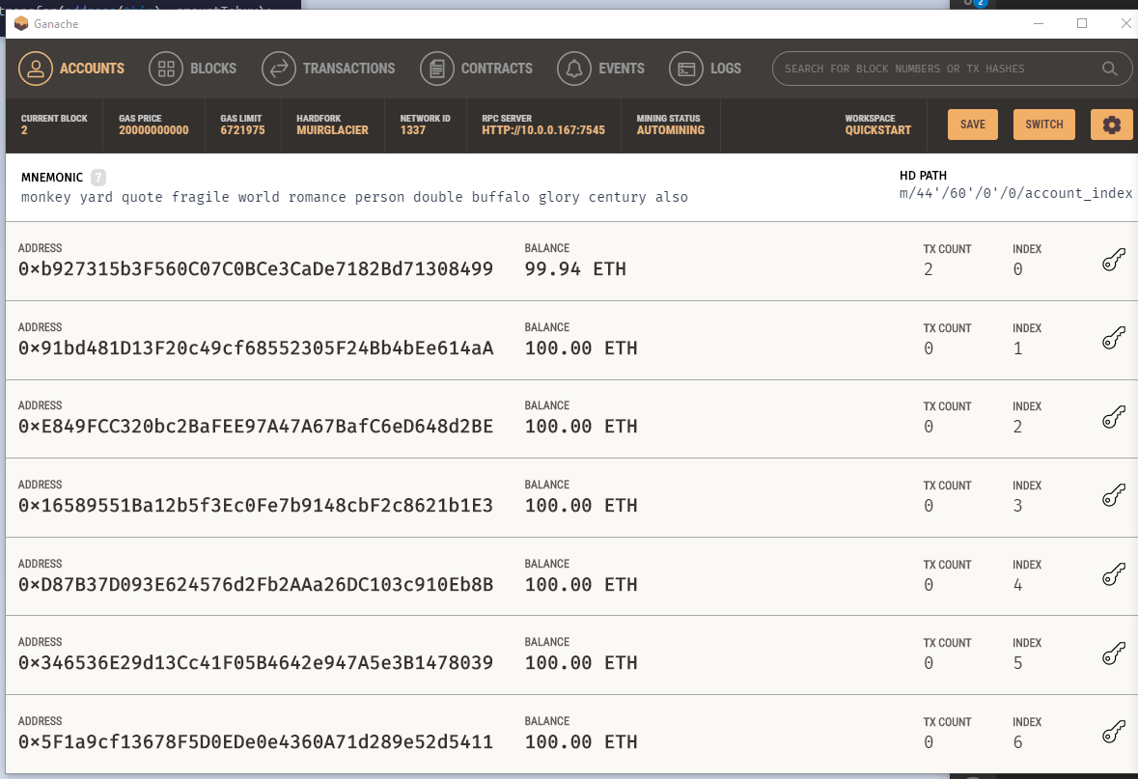
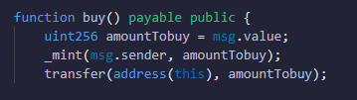
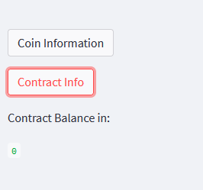
Donation Mechanism
Token is exchanged 1:1 and minted based on number of Wei deposited in the contract

Slide 7
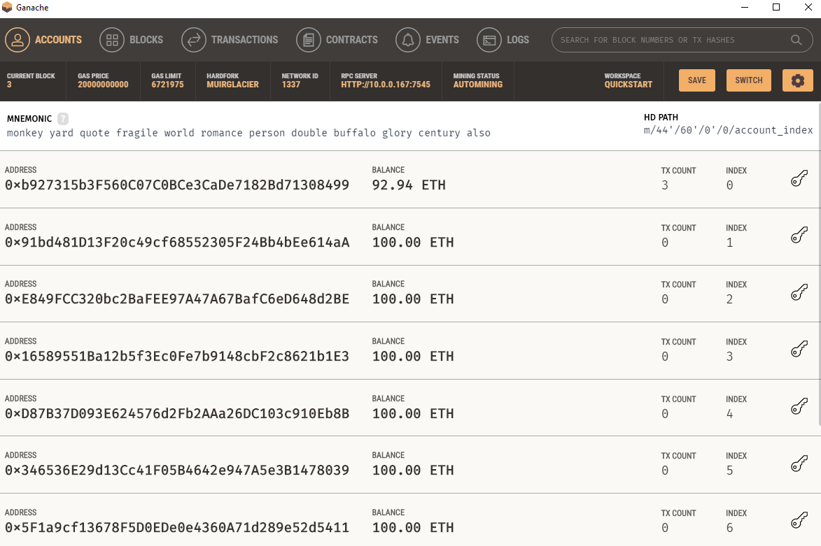
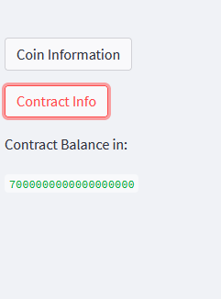
Donation Mechanism

Slide 8
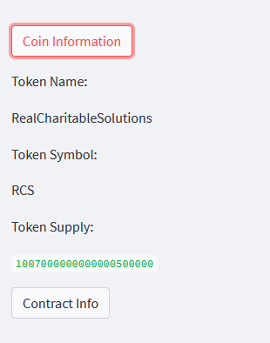
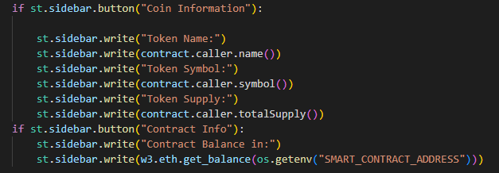
Token information

Slide 9
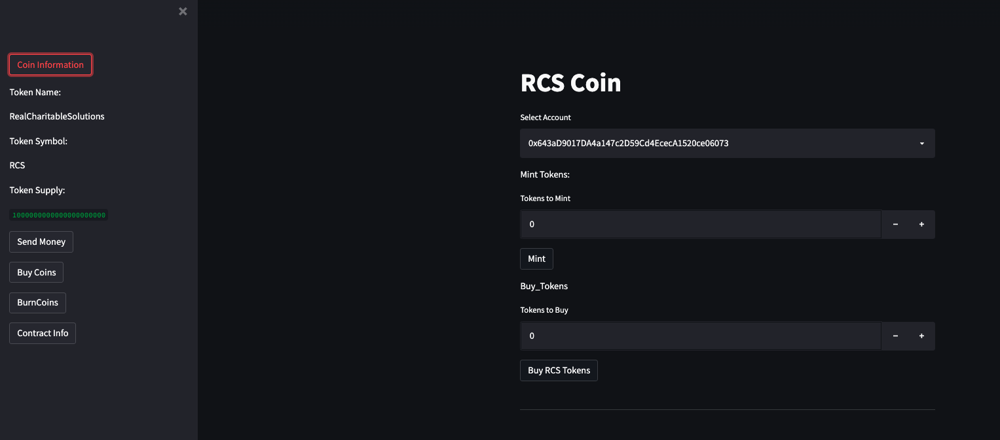
Streamlit interface for Main Charity Wallet
Your logo

Slide 10
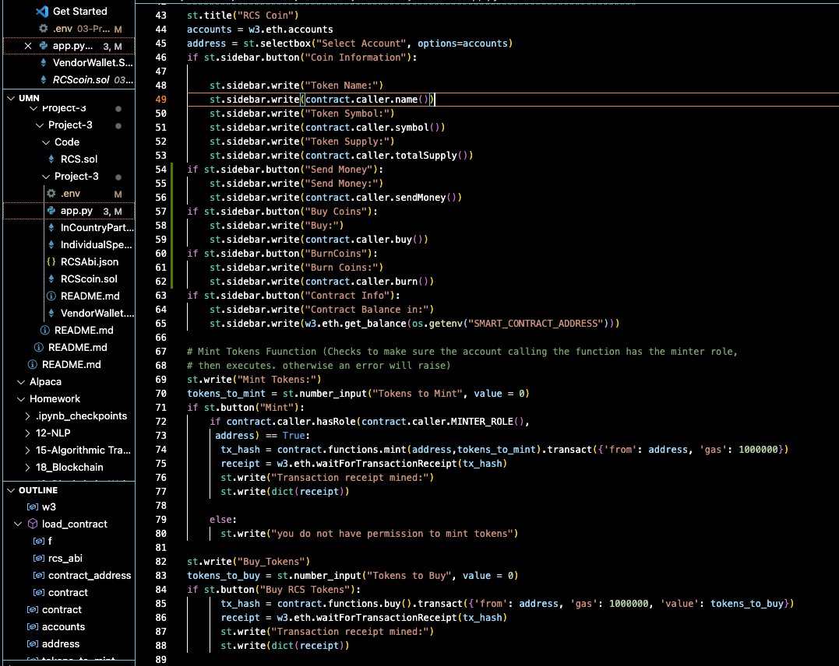
Your logo

Slide 11
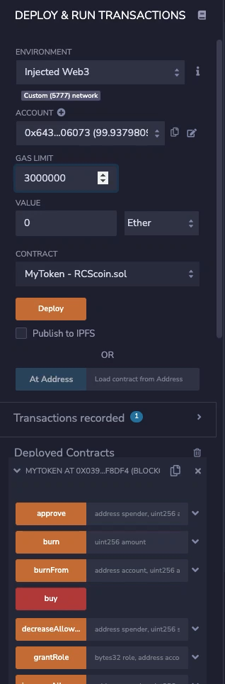
Contract Deployment for Main Charity Wallet
Your logo

Slide 12
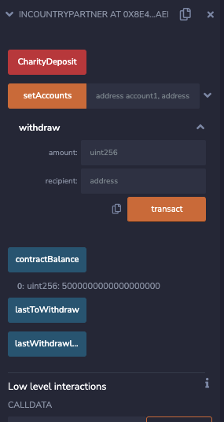
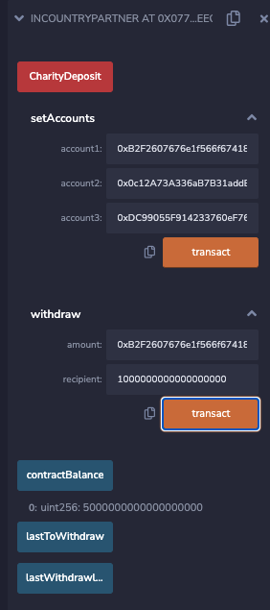
Wallet for In-Country Movement
Your logo

Slide 13
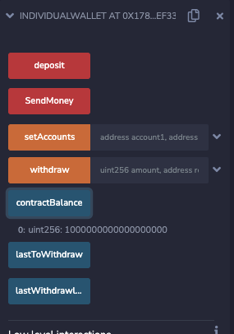
Individual Wallet
Your logo

Slide 14
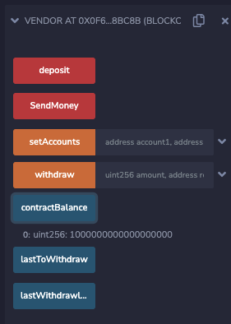
Vendor Wallet
Your logo

Slide 15
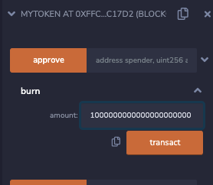
Burn Function
Your logo

Slide 16
Analysis
Failed to create a coin based on the USDC.
Using Solidity 0.8.4 we didn’t need to worry about Safe Math
Was able to create a prototype for moving coin from donor to charity.
Created a prototype system of moving coins throughout the charity, in-country partner, individual, vendor and back to the charity.
Created a burn function to keep the amounts of coins in the contracts stable per the dollar value in the contracts.
Your logo

Slide 17
Next Steps
Find a way to create the coin build based on a stable coin like the USDC.
Adjust portions of the contract to have more pass-through capability.
Rewrite contracts to make exchanging coins a more seamless transaction.
Find ways to streamline to minimize gas charges.
Test for security.
Deploy / Test…….Deploy / Test………Deploy / Test
Implement a card that would have the individuals account information to use at the vendors.
Your logo

Slide 18
Questions??

